Slide 1
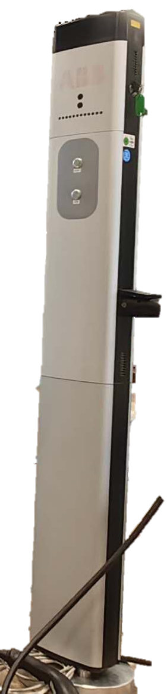
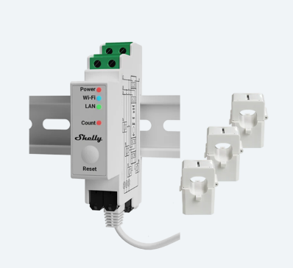
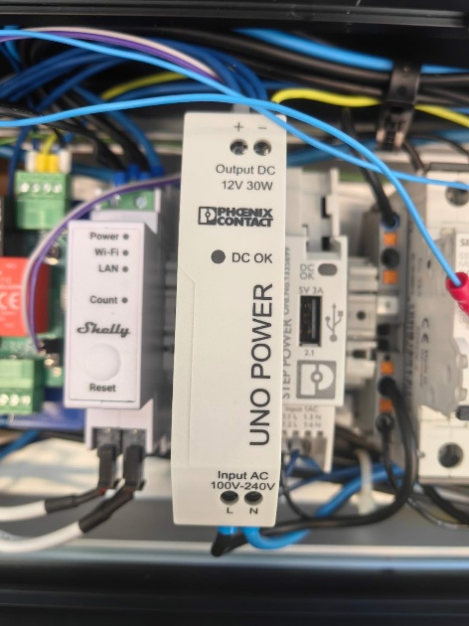
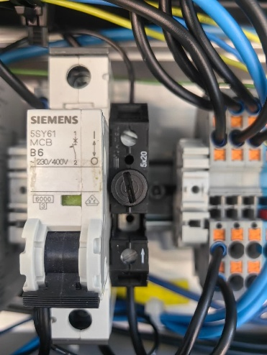
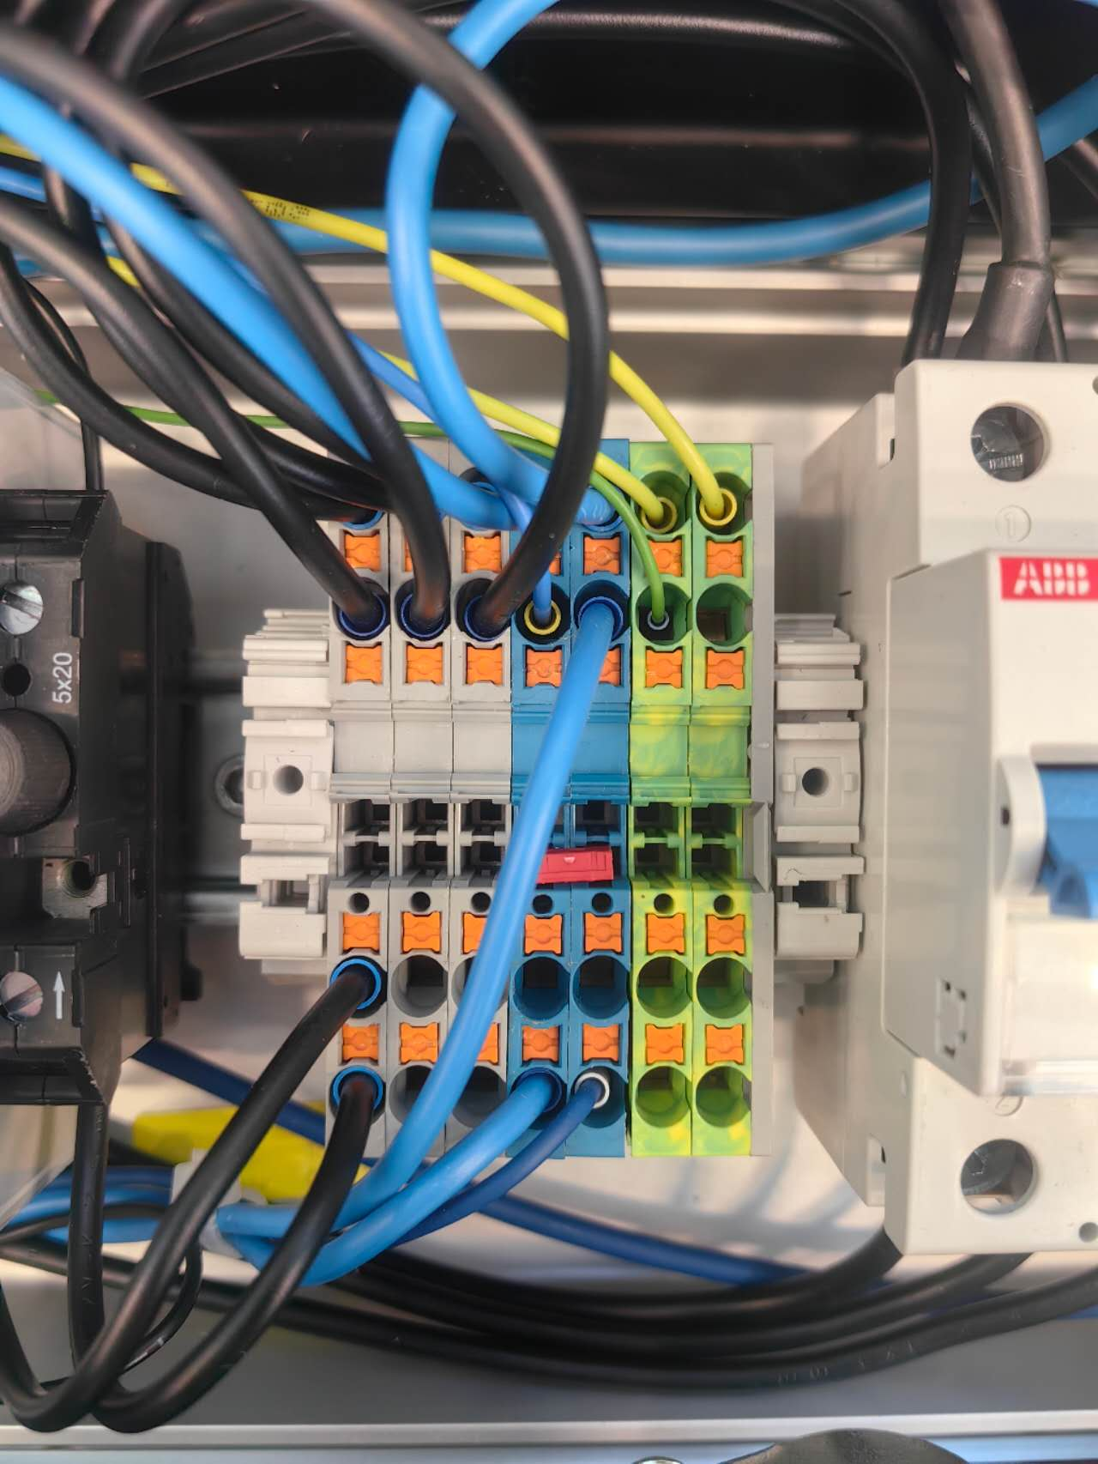
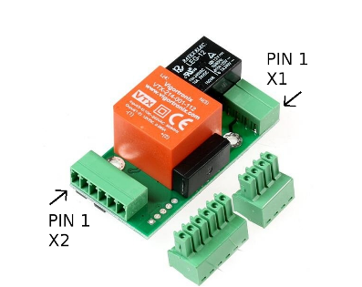
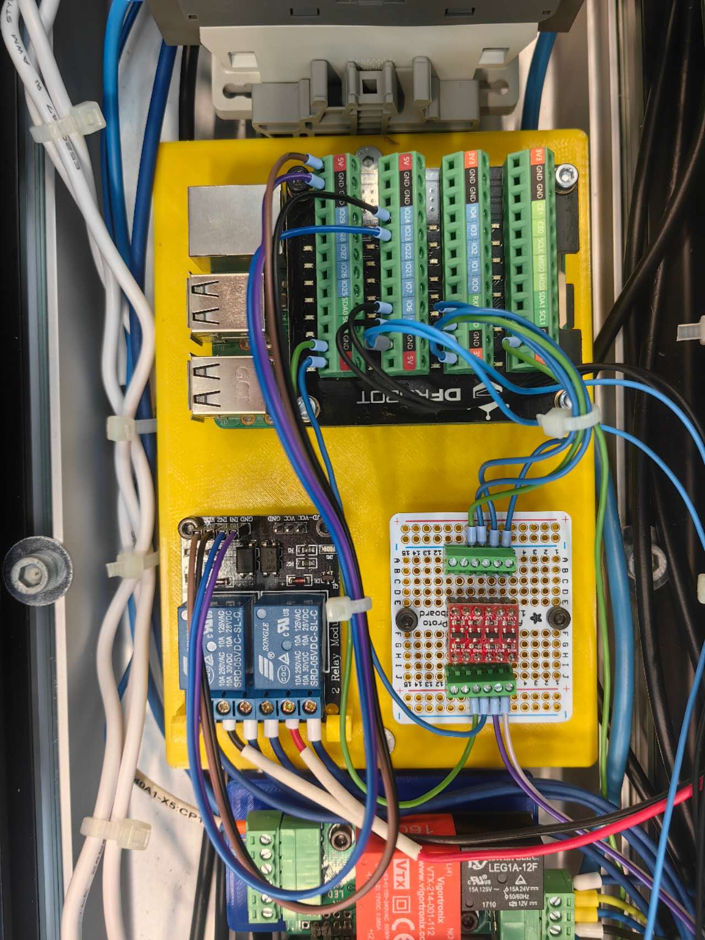
Hardware
Shelly sensor
Power supply, Circuit breaker, Fuse, Wire connector, etc.
EVSE
SmartCharge Board
Auxiliaries
Original charge station
Main functional components
Notes:
Our charging station is mainly composed of these parts

Slide 2
Main functional components
Shelly sensor
Shelly Pro 3EM
3 current clamps measure the 3-phase current: used for Data Visualization.
Record total charged energy: used for the Calibration of the charge plan.
EVSE
Electric Vehicle Supply Equipment
Communicate with EV in the form of PWM signal and voltage level, indicating the maximal allowed current and vehicle state.
Controlled by reading/writing the corresponding registers via Modbus communication
Notes:
The main functional components include a shelly sensor. This sensor can measure the current of each phase of the 3-phase power and provide data for our system.
EVSE stands for Electric Vehicle Supply Equipment. The duty cycle of PWM signal indicates the allowed current. The voltage level describes the vehicle state like whether the EV is ready or is in charging. Through Modbus communication, the system implements different functions by reading and writing different registers of EVSE.

Slide 3

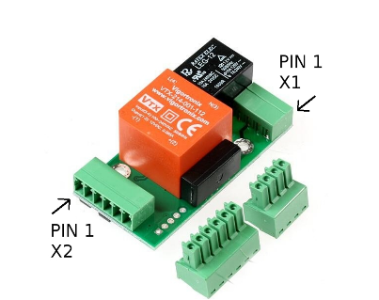
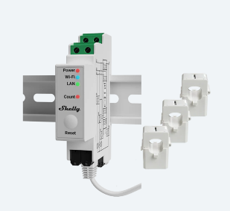
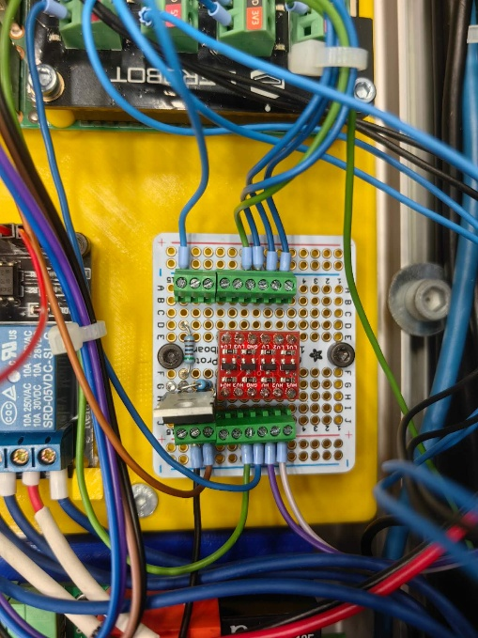
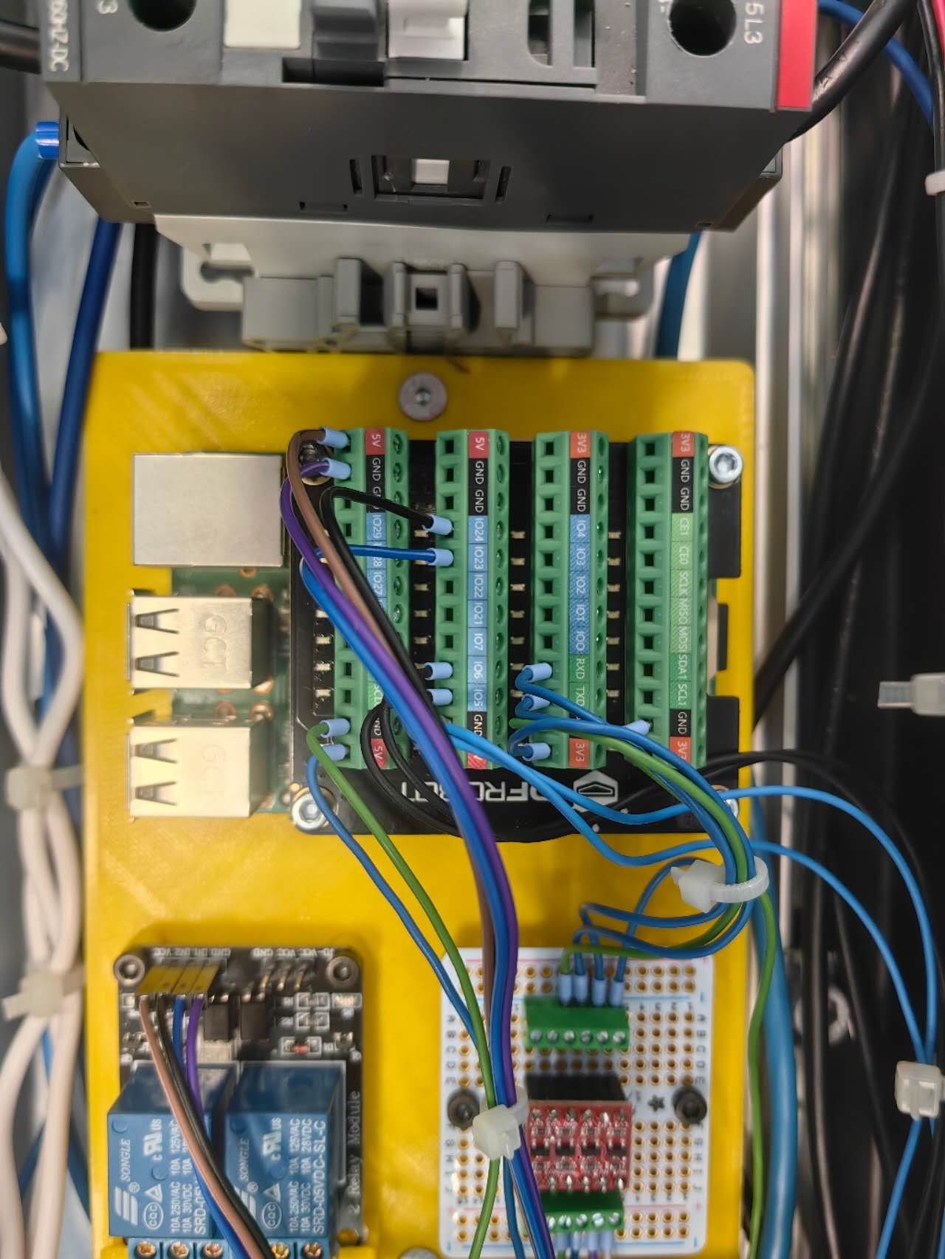

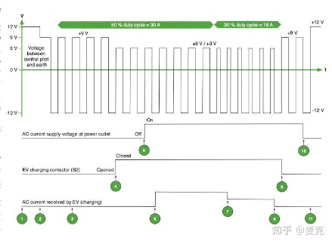

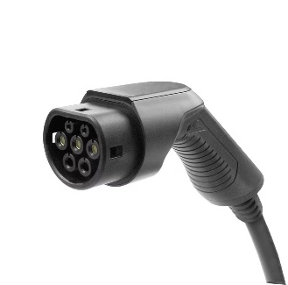
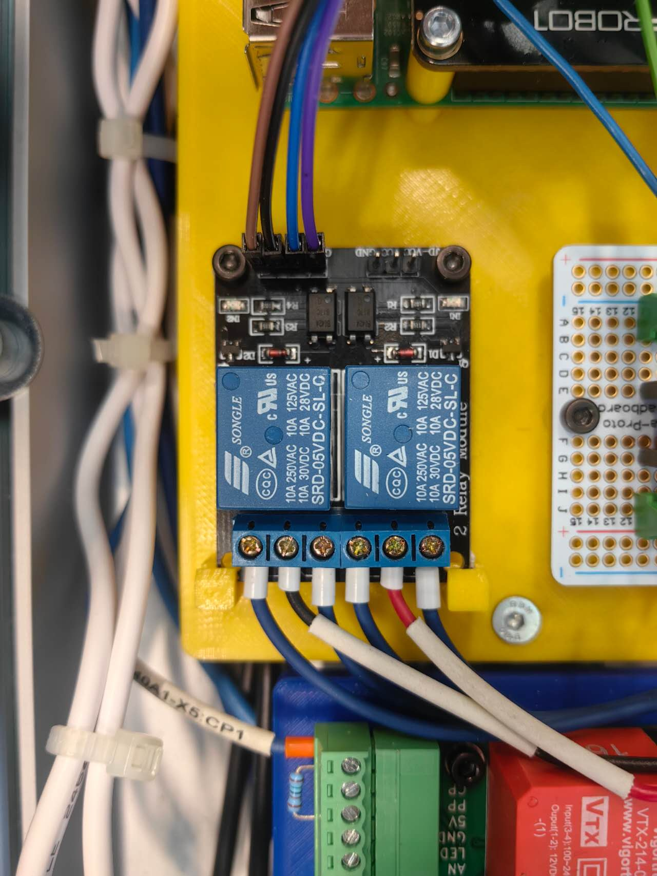
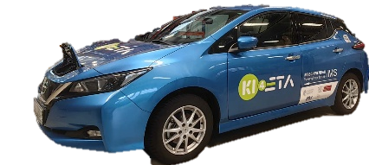
Main functional components
Server
3.5V
Level shifter
5V
EVSE
GPIO
HTTP request
Modbus
Shelly
Raspberry Pi
GPIO
LED
PWM signal
Latch motor
Relay
Notes:
The smart charge board is the most important part. It is a 3D-printed board to mount the Raspberry Pi, level shifter, and a dual channel relay.
Raspberry Pi is the carrier of the program. It is connected to the WiFi, which is provided by the Shelly sensor, and acquires the data with HTTP request.
As mentioned, the Raspberry Pi communicates with EVSE via Modbus communication. It is worth noting that the working voltage of these two parts is different. That is why we need a level-shifter in between. It prevents the Raspberry Pi from GPIO pin damage.
The EVSE communicates with the EV using PWM signal. We also used the GPIO pins of Raspberry Pi to control the latching and releasing of the charge plug by changing the rotary direction of the latch motor with a relay. We also manipulate the blinking of the LED light to indicate the charging state.

Slide 4



Charge modes
Direct charging
Manual schedule
Dynamic adjustment
Start
Stop
Buttons on the charge pile or website
Charge according to the uploaded schedule
Start time, power
The schedule is generated by the optimizer
Calibration of the charging plan periodically
Notes:
We have designed 3 charge modes.
Direct charging can literally only control the start and stop of charging, by pressing the buttons on the charge pile via the website. Then the charge station will charge at the maximum allowed current.
The Manual schedule mode is mainly used for debugging. The charging station will charge according to an uploaded schedule. The charge time point and charge power are defined in this schedule.
The dynamic adjustment mode is the main target of our project. It realizes the smart charging. The optimizer will generate the charging plan according to the user’s needs like “lowest electric price.” To compensate for the deviation in the charging process, the charge plan will be calibrated based on the data collected from our sensor.

Slide 5
Detailed charging steps
Plug in the charge plug
Select the charge mode and start
Before charging
In charging
Charging ends
EVSE:
EV is present
Check:
Vehicle,
EVSE,
Shelly, applicable plan
Latch plug
Optimizer generates the plan
Max. current to EVSE
Calibration
Polling-EVSE, Shelly
Unlatch
Clear data
If not
ERROR
Hardware failure
Notes:
At different stages of charging, our charging stations will perform different actions.
When the charge plug is inserted, the EVSE will change the value of the register, which indicates the state of the vehicle. Then the user will select the charge mode and press start. The system will check if all the components are working properly, and also check if the plan is applicable, for example, the user wants to fully charge the car in 5 minutes. It is impossible.
If everything is OK, the charge station will lock the charge plug, the Optimizer will generate the plan. The output power is controlled by changing the maximum current of EVSE. The system will periodically calibrate the plan, and get data from the EVSE and the Shelly sensor via polling. If any hardware failure occurred in this process, it will raises an error and the charging will be terminated.
After the charging is finished, the charge station will unlatch the charge plug and clear the data stored in Shelly.

Slide 6
Trim of plan
System response delay
Network delay
Charge
unit 1
1kW
2kW
1kW
2kW
Charge
unit 2
4kW
2kW
delay
4kW
2kW
Charge
unit 3
1kW
2kW
1kW
2kW
8kW
Limit
(6kW for example)
6kW
6kW
6kW
6kW
2kW
1st hour
2nd hour
1st hour
2nd hour
Notes:
In our project, we have considered a lot about the influence of delays. For example, according to the plan, three charge will charge without violating the limit of power. But due to the delay, the charge schedule of unit 2 arrived later than expected. Consequently, the total power exceeds to limitation for the same period of delay. This may cause equipment overload.

Slide 7

Trim of plan
Arrive of New schedule/
Schedule update
Now
New schedule start time is in future
Old schedule
New schedule
Time
Arrive of New schedule/
Schedule update
Now
Old schedule
New schedule after truncation
New schedule
Time
Cut off
New schedule start time already passed
Notes:
To solve this, the system will not directly execute the new schedule.
If the new schedule starts in the future, the system will wait or continue with old schedule.
If the new schedule start time is already passed, the system will cut the expired parts of the schedule, and continue with the rest parts.

Slide 8
Trim of plan
Before truncation
After truncation
Charge
unit 1
2kW
2kW
1kW
1kW
Charge
unit 2
delay
4kW
2kW
4kW
2kW
Charge
unit 3
1kW
2kW
1kW
2kW
8kW
Limit
(6kW for example)
6kW
6kW
6kW
6kW
2kW
2kW
1st hour
2nd hour
1st hour
2nd hour
Notes:
In this way, this problem is avoided and the deviation will be compensated by the following calibrated schedule.

Slide 9
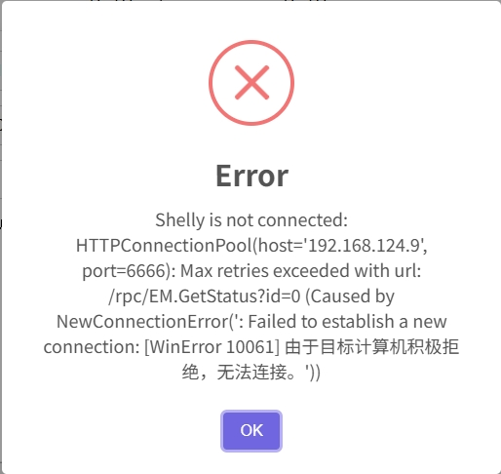
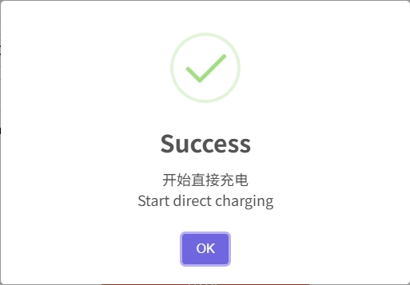
Observe the charging state
按钮图
LED light on the button
pop-up window
Notes:
In order to improve the human-machine interaction experience, apart from the pop-up window on the website, we also utilized the LED light embedded in the button. The blinking frequency of the LED indicates the current charging process.

